Slide 1
Courcera - Machine Learning 2 Week
최승완

Slide 2
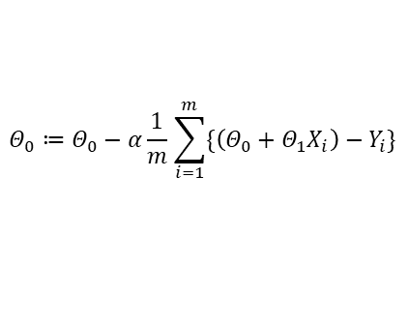
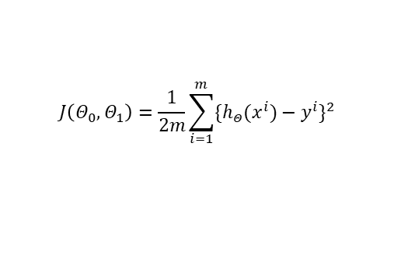

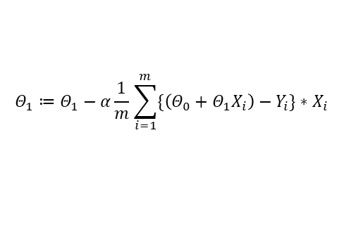
Review
How do I solve the linear regression problem ?
Hypothesis
Cost Function
Gradient Descent
$$h_{Θ}\left(x\right)=Θ_{0}+Θ_{1}x$$
$$J\left(Θ_{0},Θ_{1}\right)=\frac{1}{2m}\sum_{i=1}^{m}{{\{h_{Θ}(x^{i})−y^{i}\}}^{2}}$$
Repeat until convergence
{
}
$$Θ_{0}≔Θ_{0}−α\frac{1}{m}\sum_{i=1}^{m}{\{\left(Θ_{0}+Θ_{1}X_{i}\right)−Y_{i}\}}$$
$$Θ_{1}≔Θ_{1}−α\frac{1}{m}\sum_{i=1}^{m}{\{\left(Θ_{0}+Θ_{1}X_{i}\right)−Y_{i}\}}∗X_{i}$$
Notes:
머신러닝 설명

Slide 3
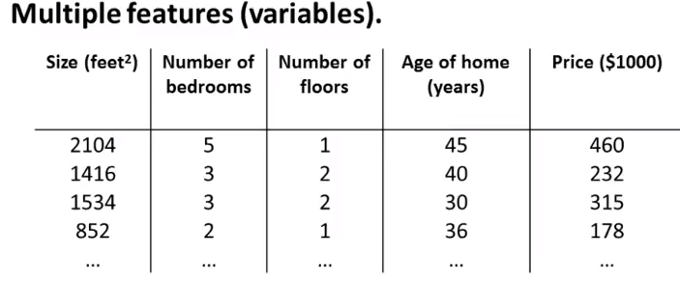
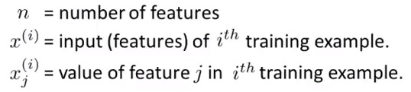






Multiple Feature
What if the number of features increases?
EX) Changes in House price for various Features.
Notation
$$x_{1}$$
$$x_{2}$$
$$x_{3}$$
$$x_{4}$$
y
$$x^{2}=\left[\begin{aligned}1416 \\ 3 \\ 2 \\ 40\end{aligned}\right]$$
$$x_{1}^{2}= 1416$$

Slide 4
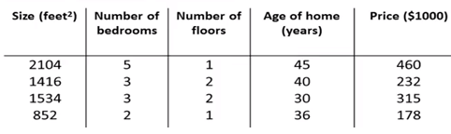


Multiple Feature
How do you express the hypothesis?
Hypothesis
→ X
Hypothesis for multiple feature
- If the number of features is n.
EX) Changes in House price for various Features.
$$h_{Θ}\left(x\right)=Θ_{0}+Θ_{1}x$$
$h_{Θ}\left(x\right)=Θ_{0}+Θ_{1}$ $x_{1}$+ $Θ_{2}x_{2}$+ $Θ_{3}x_{3}$+ $Θ_{4}x_{4}$… $Θ_{n}$ $x_{n}$
→$h_{Θ}\left(x\right)=80+0.1x_{1}$+ 0.01$x_{2}$+ 3$x_{3}−$ 2$x_{4}$

Slide 5



Multiple Feature
Let's simply express the hypothesis.
Hypothesis for multiple feature
For convenience of notation, define $x_{0}=1$.
※ $h_{Θ}\left(x\right)$ = $Θ^{T}X$ multivariate linear regression
$h_{Θ}\left(x\right)=Θ_{0}+Θ_{1}$ $x_{1}$+ $Θ_{2}x_{2}$+ $Θ_{3}x_{3}$+ $Θ_{4}x_{4}$… $Θ_{n}$ $x_{n}$
$$x=\left[\begin{aligned}x_{0} \\ x_{1} \\ x_{2} \\ \\ \\ x_{n}\end{aligned}\right]$$
$$Θ=\left[\begin{aligned}Θ_{0} \\ Θ_{1} \\ Θ_{2} \\ \\ \\ Θ_{n}\end{aligned}\right]$$
…
…

Slide 6
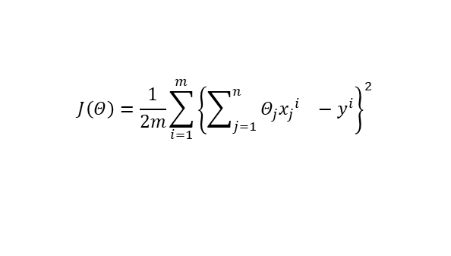
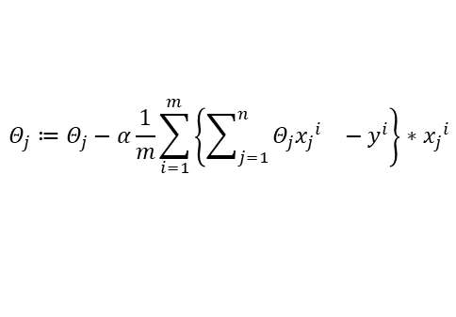
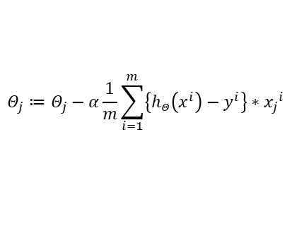

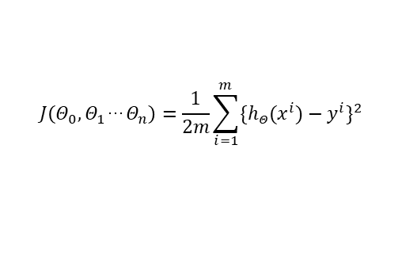

Gradient Descent
Apply to Gradient Descent
Hypothesis for multiple feature
Cost function
Gradient Descent
$h_{Θ}\left(x\right)=Θ_{0}+Θ_{1}$ $x_{1}$+ $Θ_{2}x_{2}$+ $Θ_{3}x_{3}$+ $Θ_{4}x_{4}$… $Θ_{n}$ $x_{n}$
$h_{Θ}\left(x\right)$ = $Θ^{T}X$
$$J\left(Θ_{0},Θ_{1}\text{…}Θ_{n}\right)=\frac{1}{2m}\sum_{i=1}^{m}{{\{h_{Θ}(x^{i})−y^{i}\}}^{2}}$$
$$J\left(Θ\right)=\frac{1}{2m}\sum_{i=1}^{m}{{\left\{{\sum_{j=1}^{n}{Θ_{j}{x_{j}}^{i}}}_{}−y^{i}\right\}}^{2}}$$
Repeat until convergence
{
}
$$Θ_{j}≔Θ_{j}−α\frac{∂}{∂Θ_{j}}J\left(Θ_{0},Θ_{1}\text{…}Θ_{n}\right)$$
Repeat until convergence
{
}
$$Θ_{j}≔Θ_{j}−α\frac{1}{m}\sum_{i=1}^{m}{\left\{{\sum_{j=1}^{n}{Θ_{j}{x_{j}}^{i}}}_{}−y^{i}\right\}∗{x_{j}}^{i}}$$
Repeat until convergence
{
}
$$Θ_{j}≔Θ_{j}−α\frac{1}{m}\sum_{i=1}^{m}{\left\{h_{Θ}\left(x^{i}\right)−y^{i}\right\}∗{x_{j}}^{i}}$$

Slide 7

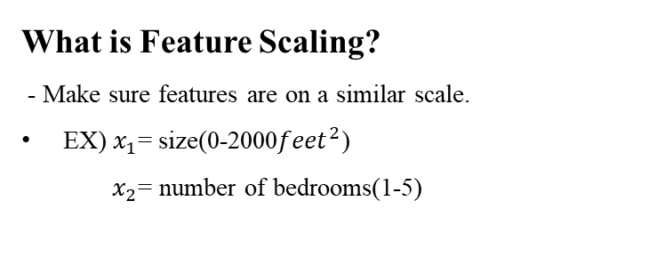

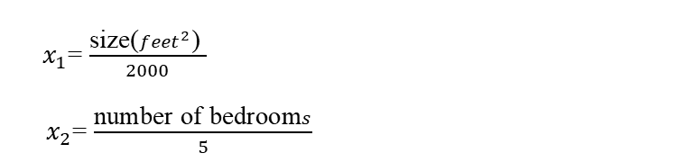




Feature Scaling
What is Feature Scaling?
- Make sure features are on a similar scale.
EX) $x_{1}$= size(0-2000${feet}^{2}$)
$x_{2}$= number of bedrooms(1-5)
$x_{1}$= $\frac{\text{size}\text{(}{feet}^{2}\text{) }}{2000}$
$x_{2}$= $\frac{\text{number} \text{of} \text{bedroom}s}{5}$
$$J\left(Θ\right)$$
$$Θ_{2}$$
$$J\left(Θ\right)$$
$$Θ_{2}$$
$Θ_{1}$
$Θ_{1}$

Slide 8
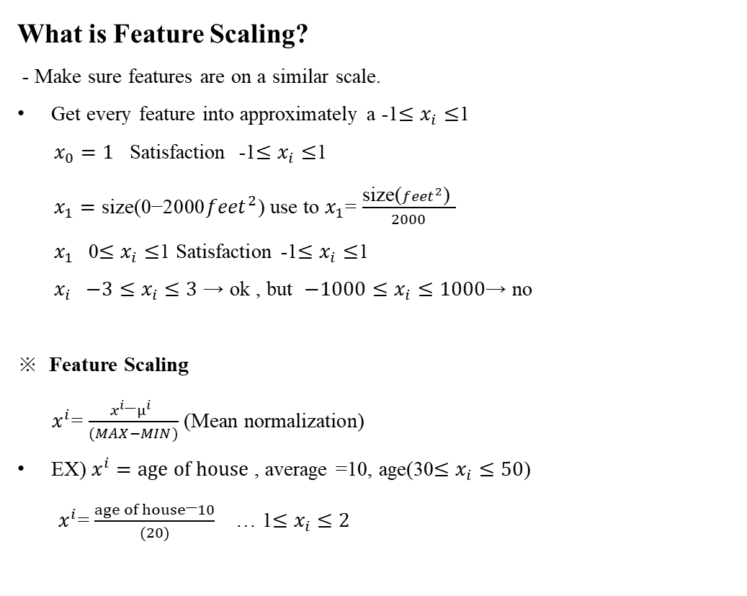
Feature Scaling
What is Feature Scaling?
- Make sure features are on a similar scale.
Get every feature into approximately a -1$≤x_{i}≤$1
$x_{0}=1$ Satisfaction -1$≤x_{i}≤$1
$x_{1}=\text{size}\text{(0−2000}{feet}^{2}\text{)} \text{use} \text{to}$ $x_{1}$= $\frac{\text{size}\text{(}{feet}^{2}\text{) }}{2000}$
$x_{1}$0$≤x_{i}≤$1 Satisfaction -1$≤x_{i}≤$1
$x_{i} \text{−3}≤x_{i}≤\text{3}$ → ok , but $\text{−}1000≤x_{i}≤\text{1000}\text{→ }\text{no}$
※ Feature Scaling
$x^{i}$= $\frac{x^{i}\text{−}μ^{i} }{(MAX−MIN)}$ (Mean normalization)
EX) $x^{i}=age of house$ , average =10, age(30$≤x_{i}≤50$)
$x^{i}$= $\frac{age of house\text{−}10}{(20)}$ … 1$≤x_{i}≤2$

Slide 9
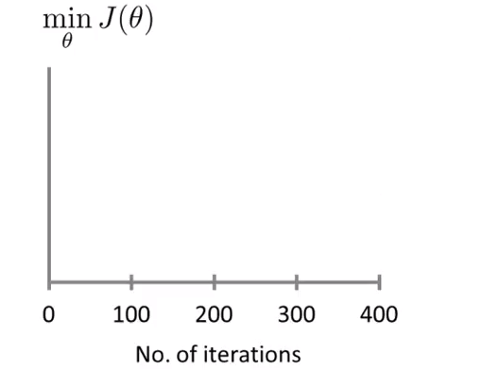
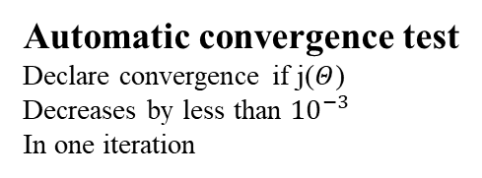
Debugging and Alpha
What is Debugging and Alpha?
- Debugging : How to make sure gradient descent is working correctly.
- Alpha : learning rate
EX ) Gradient Descent working well
Automatic convergence test
Declare convergence if j($Θ$)
Decreases by less than ${10}^{−3}$
In one iteration

Slide 10
Debugging and Alpha
What is Debugging and Alpha?
- Debugging : How to make sure gradient descent is working correctly.
- Alpha : learning rate
EX ) Gradient Descent not working
As large Alpha
→ Use smaller Alpha

Slide 11
Debugging and Alpha
What is Debugging and Alpha?
- Debugging : How to make sure gradient descent is working correctly.
- Alpha : learning rate
EX ) Gradient Descent not working
As large Alpha
→ Use smaller Alpha

Slide 12
Debugging and Alpha
What is Debugging and Alpha?
- Debugging : How to make sure gradient descent is working correctly.
- Alpha : learning rate
EX ) How to choose Alpha, try
- Draw a graph.
…, 0.001, , 0.01, , 0.1, , 1 …

Slide 13
Debugging and Alpha
What is Debugging and Alpha?
- Debugging : How to make sure gradient descent is working correctly.
- Alpha : learning rate
EX ) How to choose Alpha, try
- Draw a graph.
…, 0.001, 0.003, 0.01, 0.03, 0.1, 0.3, 1 …

Slide 14
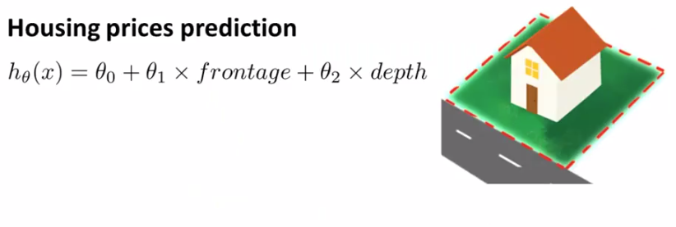

Polynomial Regression
What is Polynomial Regression?
- Regression analysis when dependent variable is represented by polynomial of independent variables.
EX)
Area = x
x= frontage $×$ depth
$h_{Θ}\left(x\right)=Θ_{0}+Θ_{1}x$(Area)

Slide 15
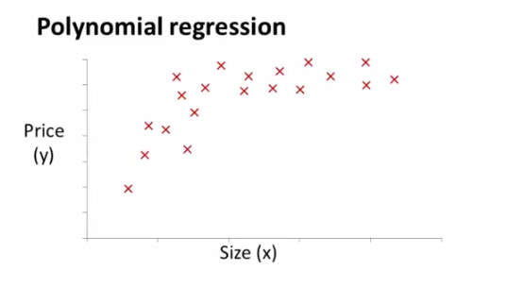

Polynomial Regression
What is Polynomial Regression?
- Regression analysis when dependent variable is represented by polynomial of independent variables.
EX)
$h_{Θ}\left(x\right)=Θ_{0}+Θ_{1}x$+$Θ_{2}x^{2}$

Slide 16
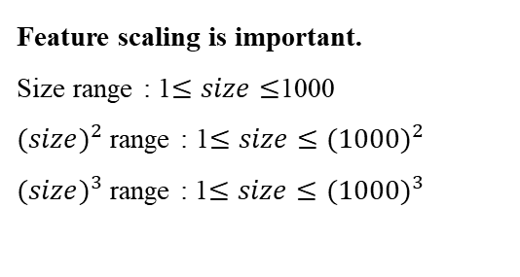
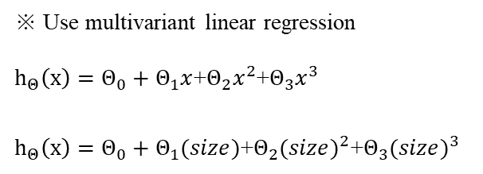
Polynomial Regression
What is Polynomial Regression?
- Regression analysis when dependent variable is represented by polynomial of independent variables.
EX)
Feature scaling is important.
Size range : 1$≤size≤$1000
${(size)}^{2}$ range : 1$≤size≤$ ${(1000)}^{2}$
${(size)}^{3}$range : 1$≤size≤$ ${(1000)}^{3}$
※ Use multivariant linear regression
$h_{Θ}\left(x\right)=Θ_{0}+Θ_{1}x$+$Θ_{2}x^{2}$+$Θ_{3}x^{3}$
$h_{Θ}\left(x\right)=Θ_{0}+Θ_{1}(size)$+$Θ_{2}{(size)}^{2}$+$Θ_{3}{(size)}^{3}$

Slide 17
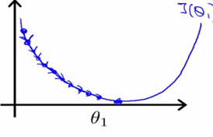
Normal Equation
What is Normal Equation?
- In certain linear regression problems, it is an effective way to find the optimal value of the parameter θ.
EX)
Normal equation
- Method to solve for θ analytically

Slide 18
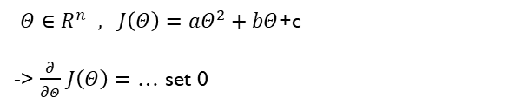

Normal Equation
What is Normal Equation?
- In certain linear regression problems, it is an effective way to find the optimal value of the parameter θ.
EX)
$$J\left(Θ_{}\right)$$
4
3
2
1
$Θ∈R^{n} , J\left(Θ\right)=aΘ^{2}+bΘ$+c
-> $\frac{∂}{∂Θ}$ $J\left(Θ\right)=$ … set 0
-1 -0.5 0.5 1 1.5 2 $Θ_{}$

Slide 19
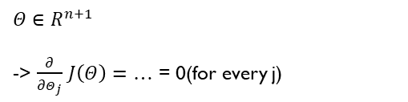
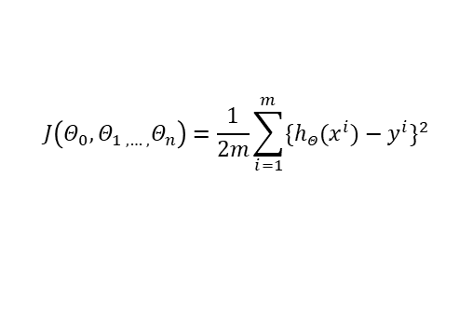
Normal Equation
What is Normal Equation?
- In certain linear regression problems, it is an effective way to find the optimal value of the parameter θ.
EX)
$$J\left(Θ_{0},Θ_{1 ,…, }Θ_{n}\right)=\frac{1}{2m}\sum_{i=1}^{m}{{\{h_{Θ}(x^{i})−y^{i}\}}^{2}}$$
$Θ∈R^{n+1}$
-> $\frac{∂}{∂Θ_{j}}$ $J\left(Θ\right)=$ … = 0(for every j)

Slide 20
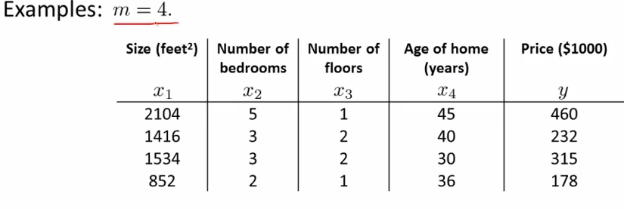



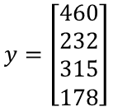
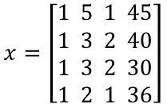

Normal Equation
What is Normal Equation?
- In certain linear regression problems, it is an effective way to find the optimal value of the parameter θ.
EX)
$$x_{0}$$
1
1
1
1
$$x=\left[\begin{aligned}1 5 1 45 \\ 1 3 2 40 \\ 1 3 2 30 \\ 1 2 1 36\end{aligned}\right]$$
$$y=\left[\begin{aligned}460 \\ 232 \\ 315 \\ 178\end{aligned}\right]$$
$$\text{θ}\text{=(}{(X^{T}X)}^{−1}X^{T}\text{Y}\text{)}$$
(m$×n+1$)
(m$×$1)

Slide 21
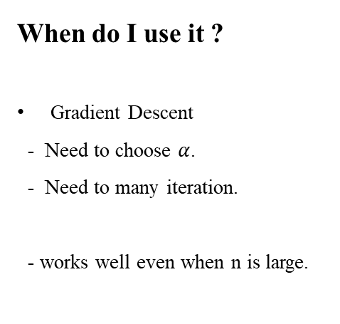
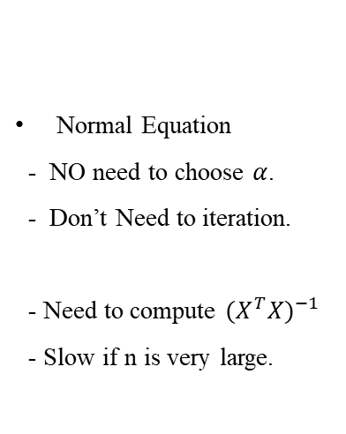
Normal Equation
When do I use it ?
Gradient Descent
- Need to choose $α$.
- Need to many iteration.
- works well even when n is large.
Normal Equation
- NO need to choose $α$.
- Don’t Need to iteration.
- Need to compute ${(X^{T}X)}^{−1}$
- Slow if n is very large.

